Slide 1
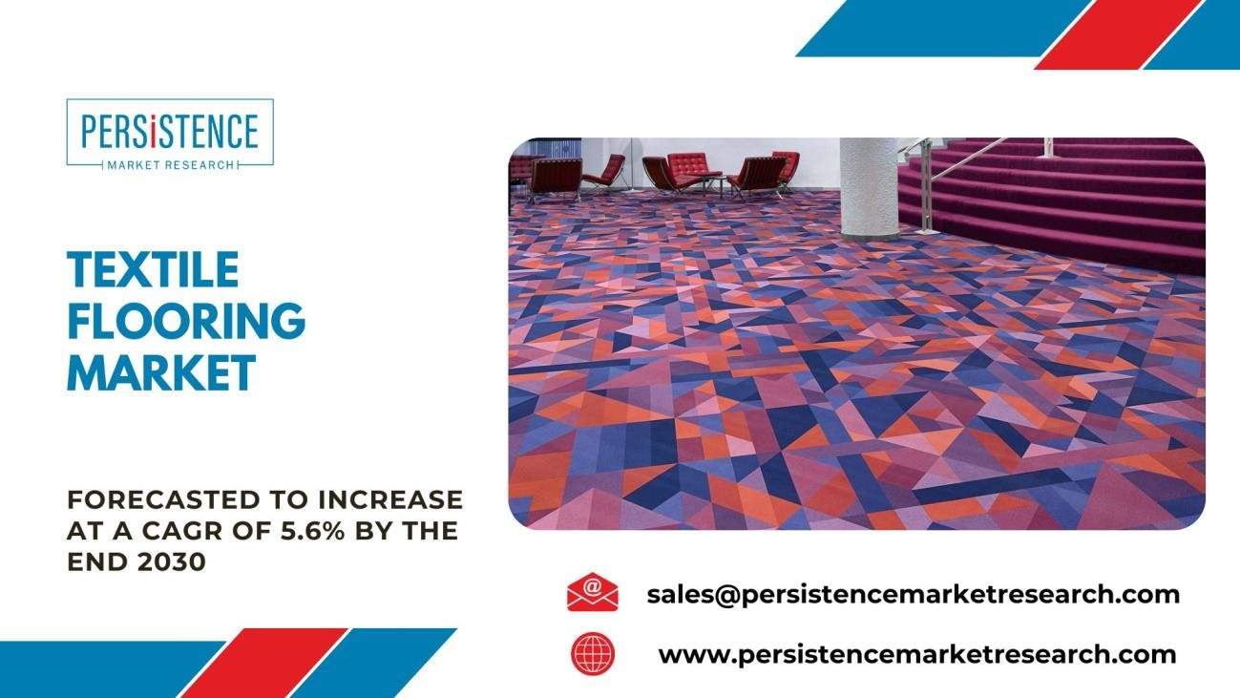
Stepping into Comfort: The Textile Flooring Market in 2023
Beneath our feet lies a world of vibrant colors, plush textures, and enduring designs. The textile flooring market, encompassing carpets, rugs, and other woven wonders, is more than just a practical choice for covering floors. It's a canvas for self-expression, a marker of comfort and luxury, and a testament to centuries of skilled craftsmanship.
Evolution of Textile Flooring: A Historical Perspective
Textile flooring has a rich history, dating back centuries when handmade rugs adorned the floors of palaces and homes of the elite. The industrial revolution marked a turning point, with the advent of mechanized carpet weaving, making these products more accessible to the general population. In the latter half of the 20th century, synthetic fibers gained prominence, revolutionizing the industry with enhanced durability and cost-effectiveness.
Market Dynamics: Global Landscape and Regional Trends
Global Overview
The global textile flooring market has witnessed significant growth in recent years, driven by factors such as urbanization, rising disposable incomes, and a growing emphasis on interior aesthetics. The market is diverse, encompassing various products such as carpets, area rugs, and carpet tiles. Key players in the market include Shaw Industries, Mohawk Industries, and Interface, among others.
Market Size and Growth Trends
The global textile flooring market is forecast to expand at a CAGR of 5.6% and thereby increase from a value of US$9.7 Billion in 2023, to US$14.3 Billion by the end of 2030. The growing

Slide 2
emphasis on interior aesthetics, the surge in construction activities, and the increasing preference for sustainable and recyclable flooring materials are key drivers of market expansion.
Regional Trends
The market exhibits regional variations influenced by cultural preferences, economic factors, and lifestyle choices. In North America, for instance, carpeted flooring remains popular in residential settings, providing warmth and comfort. In contrast, the European market leans towards sleeker options such as carpet tiles, reflecting a preference for modern and minimalist design.
Emerging Markets
Asia-Pacific has emerged as a lucrative market for textile flooring, fueled by rapid urbanization in countries like China and India. The region's expanding middle class and growing awareness of interior design trends contribute to the increasing demand for high-quality, aesthetically pleasing flooring solutions.
Key Trends Shaping the Textile Flooring Market
Sustainability: In an era marked by environmental consciousness, sustainability has become a pivotal factor in the textile flooring market. Manufacturers are increasingly adopting eco-friendly materials, recycled fibers, and sustainable production processes. Consumers, too, are prioritizing products that align with their commitment to environmental responsibility.
Technology Integration: Advancements in technology have permeated the textile flooring industry, leading to innovations such as smart carpets and interactive floor coverings. These products, embedded with sensors and technology, offer functionalities beyond traditional flooring, including temperature regulation, energy efficiency, and even interactive gaming experiences.
Customization: Consumers today seek personalized and unique design elements for their living spaces. The textile flooring market has responded with a surge in customizable options, allowing customers to choose patterns, colors, and textures that align with their individual tastes and preferences.
Health and Wellness: With a growing awareness of the impact of indoor environments on health, there is a rising demand for flooring solutions that contribute to a healthier living space.
Antimicrobial treatments, hypoallergenic materials, and easy maintenance features are increasingly integrated into textile flooring products.
Challenges in the Textile Flooring Industry
Despite its growth, the textile flooring industry faces certain challenges that necessitate strategic adaptation:
Fluctuating Raw Material Prices: The industry heavily relies on raw materials such as nylon, polyester, and polypropylene. Fluctuations in the prices of these materials can impact manufacturing costs, posing a challenge for market players.
Intense Competition: The textile flooring market is highly competitive, with numerous players vying for market share. Differentiation through innovation, branding, and strategic partnerships is crucial for sustained success.

Slide 3
Shifting Consumer Preferences: Consumer preferences are dynamic, influenced by changing design trends, economic factors, and cultural shifts. Staying attuned to these shifts and adapting product offerings accordingly is a perpetual challenge for industry players.
Market Segmentations
By Product Type:
Rugs
Carpets By Technology:
Tufting
Woven
Needlefelt By Material Type:
Synthetic Textiles
Polypropylene
PET
Acrylic
Nylon
Animal Textiles
Wool
Fur
Plant Textiles
Grass
Sisal By Application:
Residential
Commercial
Others (Industrial, etc.)
Regional Market Dynamics
North America: The North American Textile Flooring market is driven by the demand for premium and customized flooring solutions in residential and commercial spaces. Sustainability initiatives also influence market trends.

Slide 4
Europe: Europe is a significant player in the Textile Flooring market, with a focus on design aesthetics, high-quality materials, and sustainability. The region's commitment to environmental standards supports the adoption of eco-friendly flooring options.
Asia-Pacific: The Asia-Pacific region is experiencing rapid market growth, propelled by urbanization, increased disposable income, and a growing awareness of interior design trends. The construction boom in countries like China and India contributes to market expansion.
Global Industry Analysis, Size, Share, Growth, Trends, and Forecast 2023-2030: https://www.persistencemarketresearch.com/market-research/textile-flooring- market.asp
Key Players
The Textile Flooring market features key players at the forefront of innovation and market competitiveness. Some prominent players include:
Mohawk Industries
Shaw Industries Group
Interface, Inc.
Beaulieu International Group
Tarkett
Balta Group
Dixie Group
Brintons Carpets Limited
Mannington Mills, Inc.
Market Mergers & Acquisitions
The Textile Flooring Market is witnessing notable mergers and acquisitions, driving industry consolidation. Strategic alliances and acquisitions aim to broaden product portfolios, expand market presence, and leverage emerging trends in sustainable and innovative flooring solutions. This trend reflects the commitment of industry players to address evolving consumer demands and market dynamics.
Investment Opportunities and Risks:
The Textile Flooring market presents attractive investment opportunities driven by the growing demand for innovative and sustainable flooring solutions. Investments in research and development to create new materials, improve manufacturing processes, and enhance technological integration can position companies for long-term success.
However, risks such as fluctuations in raw material prices, competitive market dynamics, and the need for continuous innovation pose challenges. Strategic planning, market intelligence, and a commitment to quality and sustainability are essential for mitigating these risks and maintaining a competitive edge.

Slide 5
Future Outlook and Opportunities
The textile flooring market is poised for continued growth, driven by several factors:
E-commerce Expansion: The rise of e-commerce has opened up new avenues for market players to reach consumers directly. Online platforms provide a convenient channel for purchasing and exploring a wide range of textile flooring options, facilitating market expansion.
Integration of Artificial Intelligence: Artificial intelligence (AI) is gradually making its presence felt in the flooring industry. AI-driven solutions offer enhanced predictive analytics, enabling manufacturers to optimize production processes, forecast demand more accurately, and improve overall operational efficiency.
Continued Innovation: Innovation will remain a key driver of success in the textile flooring market. Continued research and development efforts to create novel materials, designs, and functionalities will set industry leaders apart and cater to the evolving demands of consumers.
Key Questions Answered in the Report:
What are the current trends in the Textile Flooring market?
How are technological innovations shaping the landscape of textile flooring solutions?
What is the regulatory framework governing the production and use of textile flooring materials?
What are the investment opportunities and associated risks in the market?
How has the COVID-19 pandemic impacted the Textile Flooring market?
What are the future projections for the market, considering evolving trends?
Who are the key players in the Textile Flooring market, and what are their strategies?
How do regional factors influence market trends and opportunities?
What emerging technologies are expected to impact the Textile Flooring market?
How does the competitive landscape look, and what is the market positioning of key players?
Read More Trending “PMR Exclusive Article”:
Market Study on Sodium Ion Battery
Market Study on Distributed Acoustic Sensing About Persistence Market Research:
Business intelligence is the foundation of every business model employed by Persistence Market Research. Multi-dimensional sources are being put to work, which include big data, customer experience analytics, and real-time data collection. Thus, working on “micros” by Persistence Market Research helps companies overcome their “macro” business challenges.

Slide 6
Persistence Market Research is always way ahead of its time. In other words, it tables market solutions by stepping into the companies’/clients’ shoes much before they themselves have a sneak pick into the market. The pro-active approach followed by experts at Persistence Market Research helps companies/clients lay their hands on techno-commercial insights beforehand, so that the subsequent course of action could be simplified on their part.
Contact Us:
Persistence Market Research Teerth Technospace, Unit B-704 Survey Number - 103, Baner Mumbai Bangalore Highway Pune 411045, India
Email: sales@persistencemarketresearch.com
Web: https://www.persistencemarketresearch.com

